Slide 1
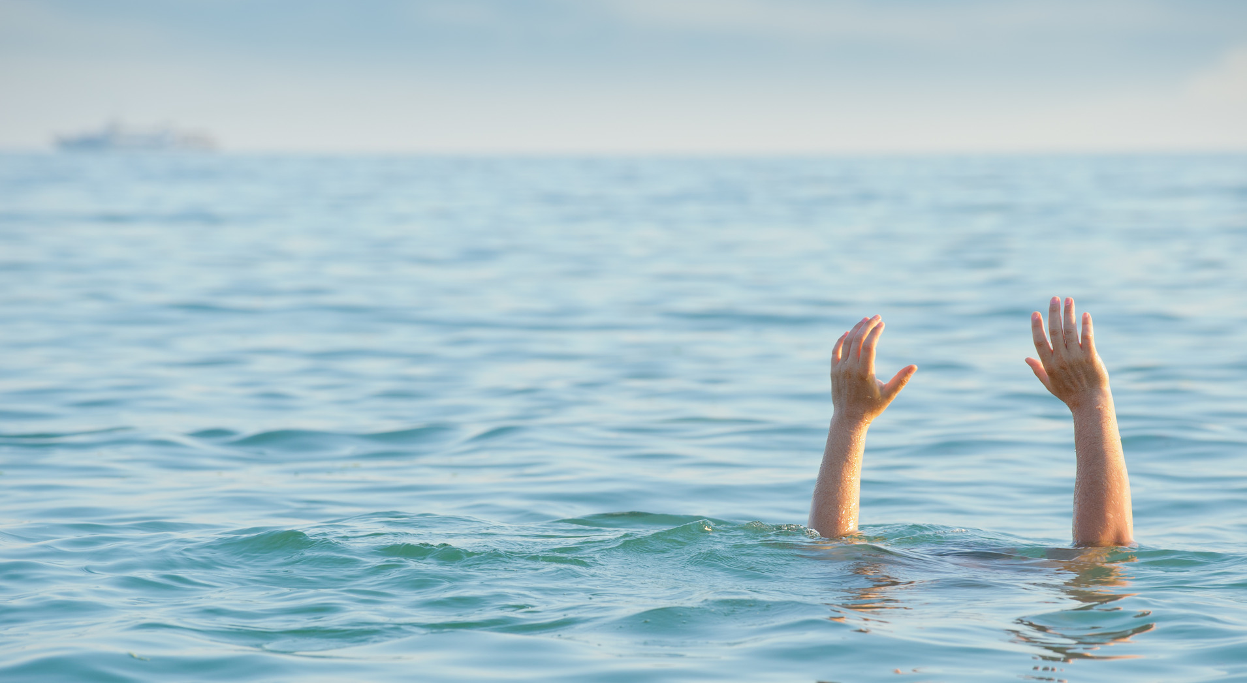
Initial response for drowning case
Group Number: 16
Team Members:
Nir – Biotech engineering – nirmaor1991@gmail.com
Dvir – Mechanical engineering – dvireini5@gmail.com
Elior – Mechanical engineering – Elior35@gmail.com
Mor – Electrical Engineering – morg930@gmail.com
Valentin – Computer Science – ValkAD@Gmail.com
Our project is open source!
https://github.com/ValkA/SmartLifeBelt

Slide 2
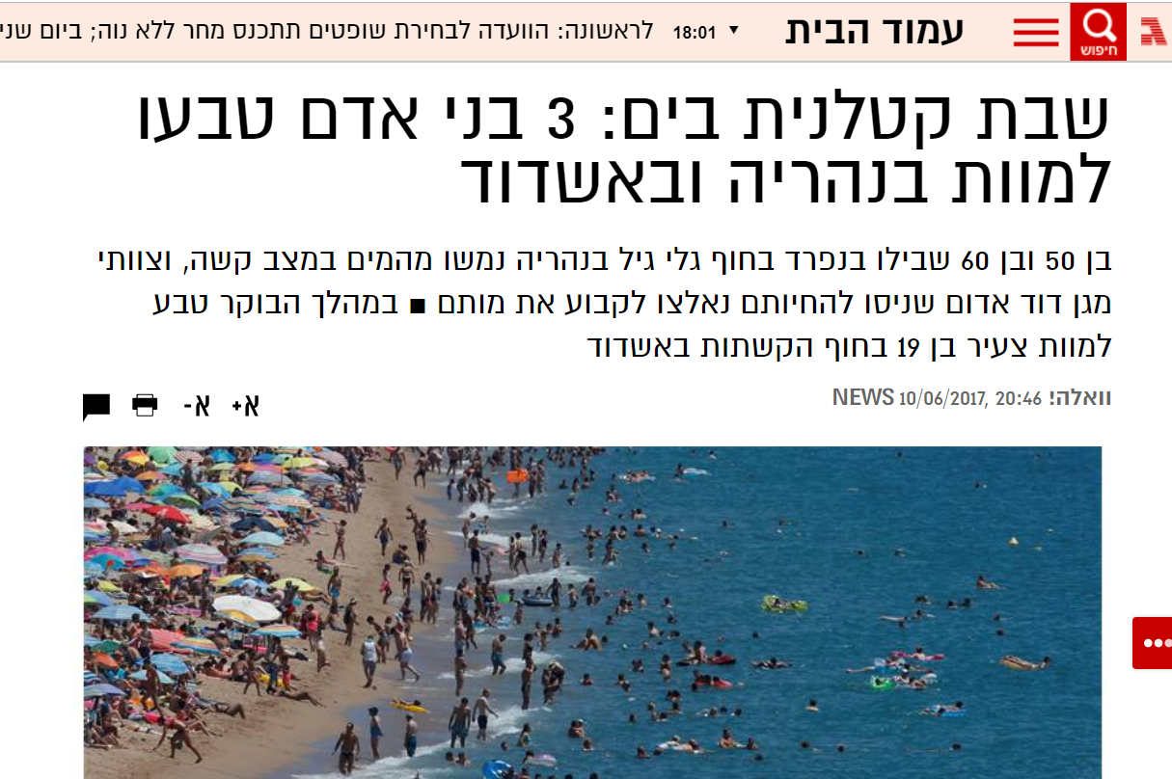
A problem
Drowning cases (49 deaths only in Israel this year).
Loss of critical time – Golden time.
Saving lives.

Slide 3

Government costs for medical and legal expenses
1,433,739 - 4,030,717₪, PER PERSON!
https://www.orendin.com/פיצויים-בגין-נזקי-טביעה/

Slide 4
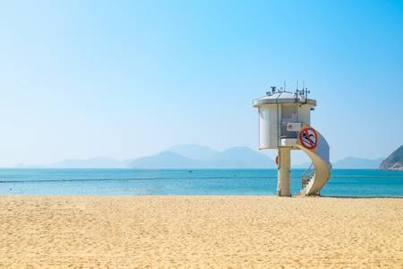
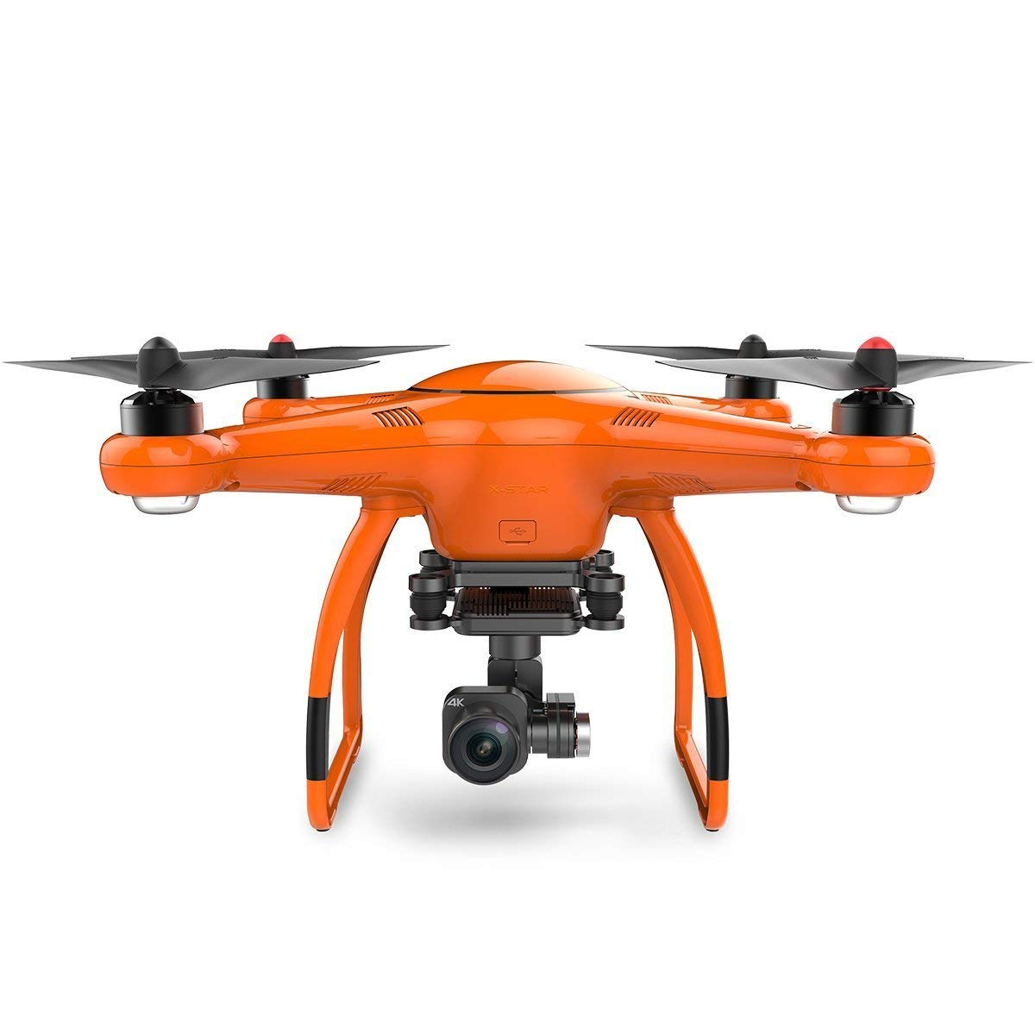
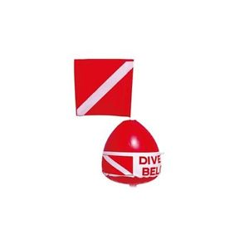

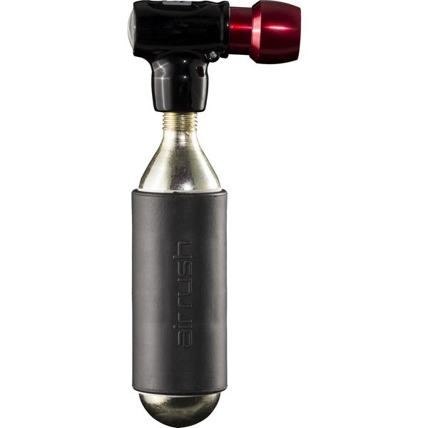
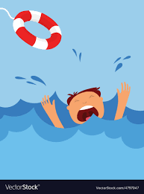
Our solution
Smart camera.
Drone launch.
Drone drops smart life belt.
Inflation of smart belt.
Target safely waits for a lifeguard.
CO2

Slide 5
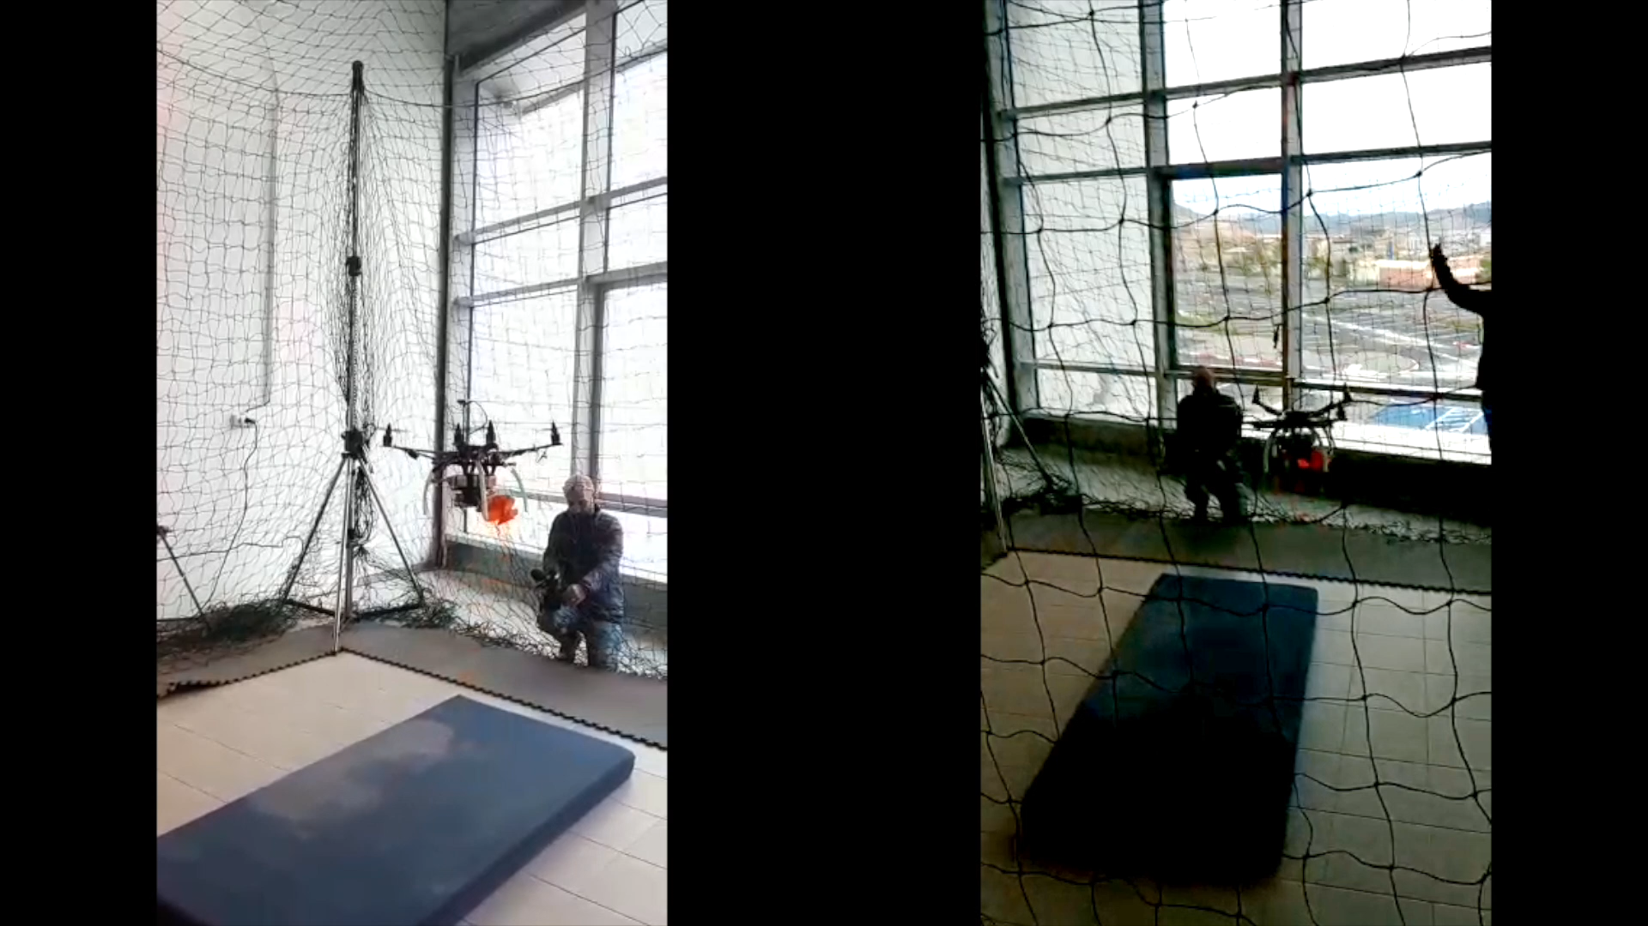

Slide 6
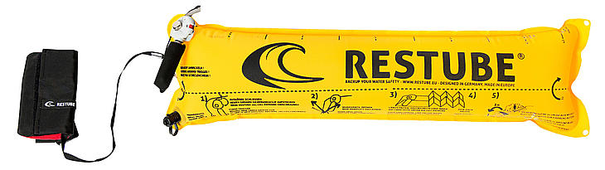
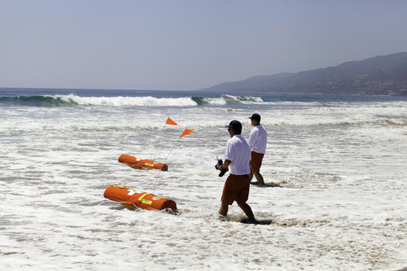
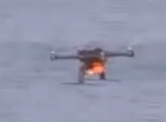
Existing solutions:
Microdrones
EMILLY
Blueskimmer
Windy conditions
EMILLY
Our solution
Microdrones
Blueskimmer
Wavy conditions

Slide 7
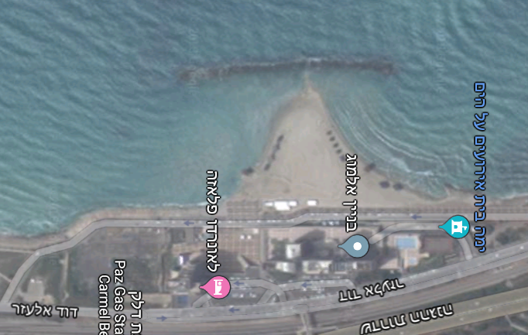
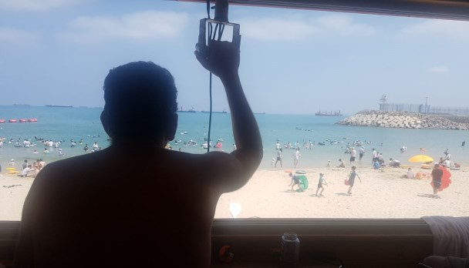

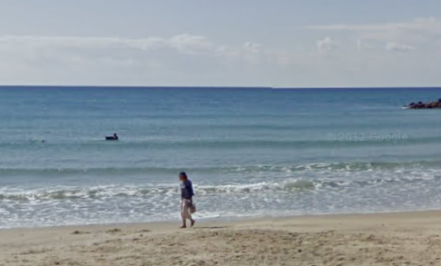
From life guard’s tower
Smart camera uses AI to scan and classify swimmers behavior.
Camera (x,y) coordinates translated to (latitude,longitude) for the drone

Slide 8
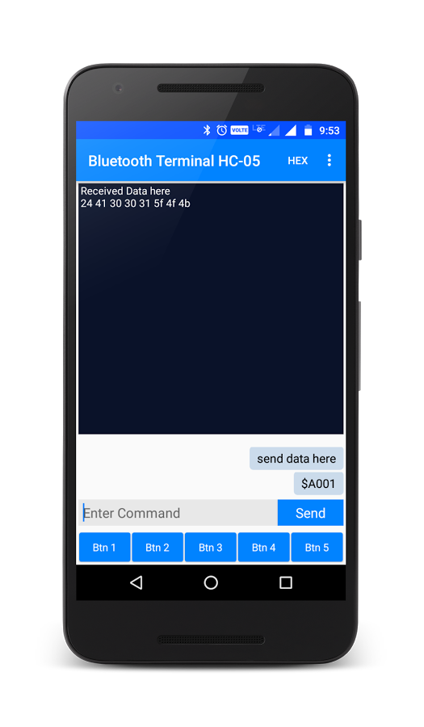
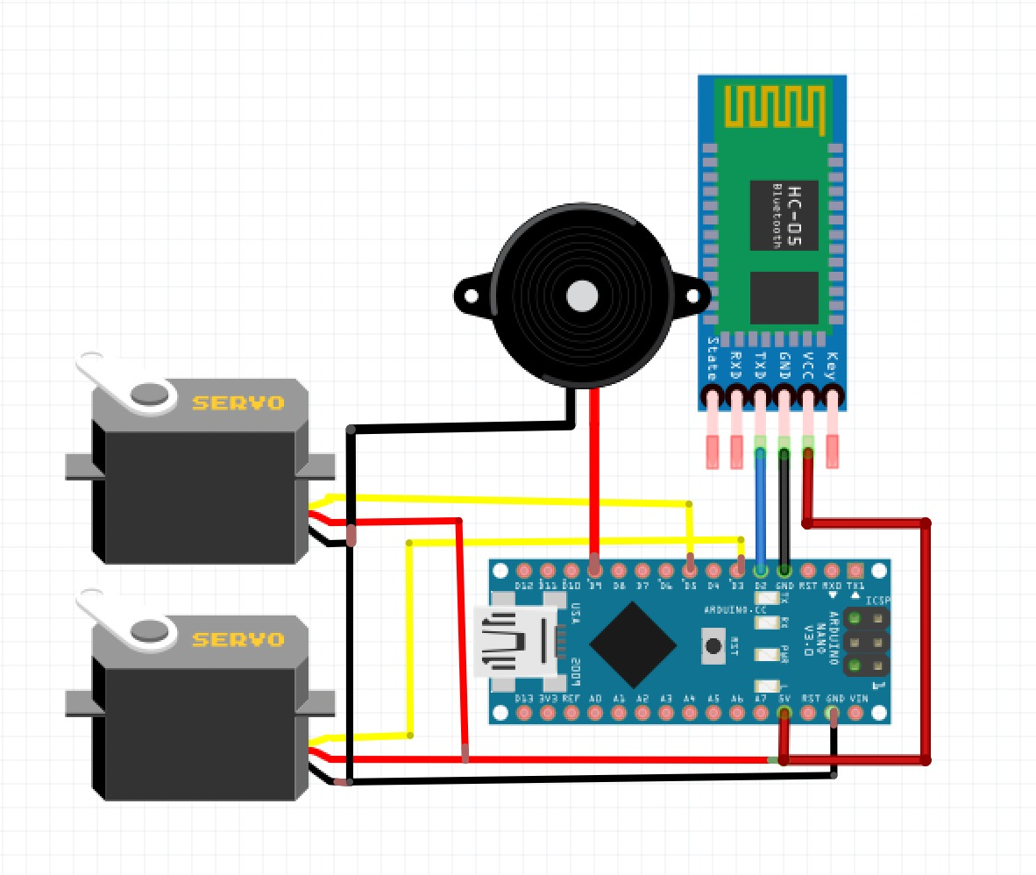
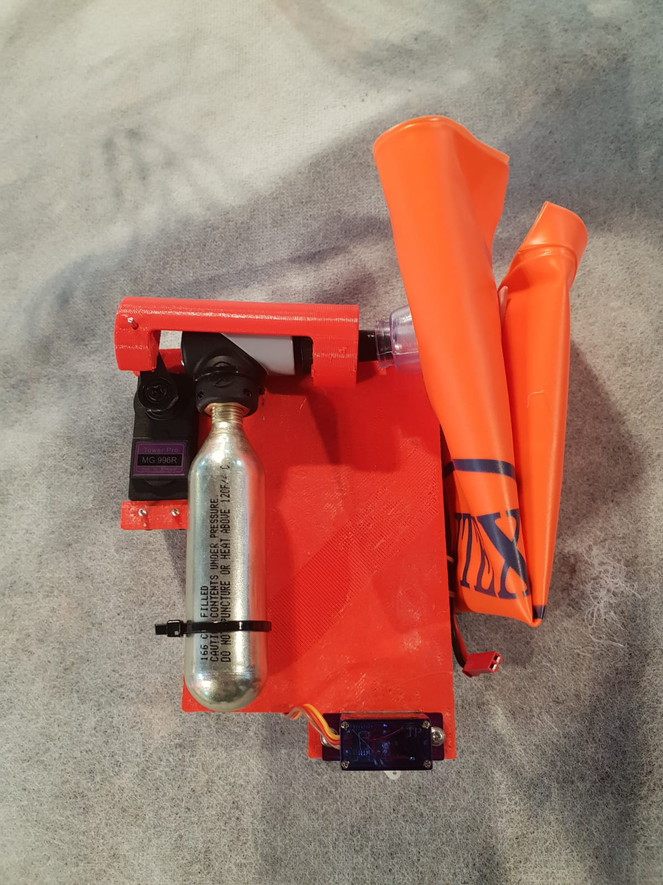

System Description:
We succeeded to deliver the following prototype:
3D printed case. Holds electronics and inflator together on the Drone
Arduino with Bluetooth and servos
Android Bluetooth terminal

Slide 9
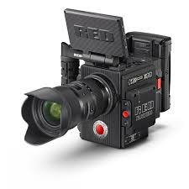
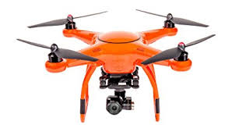
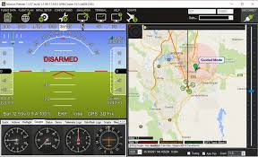
System Description:
AI on the Cloud (Amazon/Google/Microsoft/IBM)
Plans for the future:
Train swimmers classifier on one of the clouds which will recognize if swimmer is drowning or not
Classified swimmers
Camera frames
Go to and drop command
Translate camera pixel coordinates to latitude longitude and update Mission Planner with new location to be handled.

Slide 10
Thank you!
Our Code, Diagrams and 3D models are open sourced https://github.com/ValkA/SmartLifeBelt

